Slide 1
Special Purpose Trees: Tries and Height Balanced Trees
CS 3100 – Data Structures & Algorithms
Lecture materials adapted from:
Coursenotes
A Practical Introduction to
Data Structures and Algorithm Analysis
Second Edition
Clifford A. Shaffer
Department of Computer Science
Virginia Tech
Copyright © 2000, 2001

Slide 2
Space Decomposition
BST – object space decomposition
  The shape of the tree depends on the order in which the keys are added
  Each key add splits the space into two parts, based on the key value
  Example: 70, 80
Values from 1 to 100
70
1 to 69
70 to 100
80
70 to 89
80 to 100
Advanced Trees

Slide 3
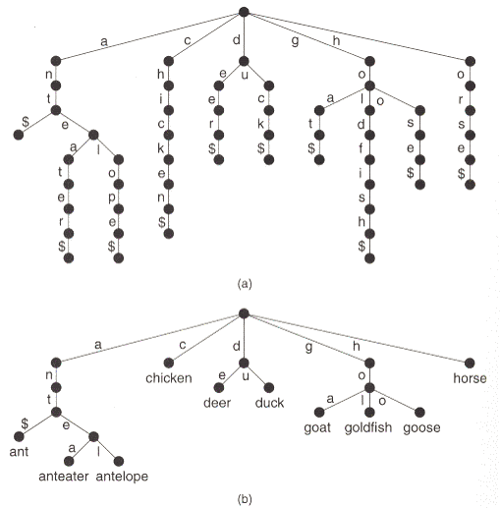
Alphabet trie
Branching factor can be greater than 2:
Advanced Trees

Slide 4
Key Space Decomposition
We might prefer to evenly split the space based on the possible key values:
A tree based on key space
decomposition is called
a trie.
40
20
60
10
30
50
70
0
10
20
30
40
50
60
70
Advanced Trees

Slide 5
Binary Tries
If the key is an integer, we can split the space into two equal halves by looking at a single bit of the key
  Example: 8-bit key, values from 0 to 255
  0xxxxxxx = 0 to 127
  1xxxxxxx = 128 to 255
  00xxxxxx = 0 to 63
  01xxxxxx = 64 to 127
Values only at the leaf nodes!
0
1
132
0
1
53
71
Advanced Trees

Slide 6
A Binary Trie
0
1…
0
1
120
0
1…
0
0
0
1…
The trie will be the same shape, regardless of the order of insertion.
24
0
1
0
1
1
40
0…
1…
0
1
32
37
2
7
A binary trie for input set {2, 7, 24, 32, 37, 40, 120}
  Internal nodes don’t need to store anything: left=0, right=1
Advanced Trees

Slide 7
Bitwise operations in C++
unsigned char i, j; // eight-bit values
i = 3; // i = 00000011
j = i << 4; // j = 00110000 (48)
// Testing a single bit:
i = 1 << 4; // i = 00010000
i = i & j; // bitwise AND, i = 00010000
if (i) {} // if i==0, the bit was 0
else {} // otherwise it was 1
Advanced Trees

Slide 8
Wasted space
What if we add only 2, 7 and 32 to our binary trie?
0
0
1
A lot of wasted space for nodes with only one child.
Only two decisions to make.
0
0
32
0
1
2
7
Advanced Trees

Slide 9
Compressing a trie
PATRICIA trie:
  Only include
  nodes with more
  than one child
  Levels do not
  always test a
  fixed bit position
  Each node stores a
  bit index, and a value
0
000
100000
010
111
32
2
7
Advanced Trees

Slide 10
Balanced Trees
Binary search tree performance suffers when the tree is unbalanced
The AVL tree is a BST with the following additional property: For every node, the heights of its left and right subtrees differ by at most 1.
  The depth of an n node tree will be, at most, O(log n), so search and insert are O(log n) operations, even in the worst case.
  Insert and delete must maintain tree balance.
Advanced Trees

Slide 11

An unbalanced BST
s
The pivot node, is called
s. This is the “bottom-most unbalanced node. The rotator node is the node to “hook” and “pull”
37
24
42
7
2
37
7
42
2
24
Advanced Trees

Slide 12
Handling both children
What if r has two children?
50
40
60
30
45
20
Well, this node just lost a child, right?
40
30
45
50
20
60
Where can we put this?
Advanced Trees

Slide 13
Single Rotation
40
30
45
50
20
60
40
30
50
Ta dah!
20
45
60
Advanced Trees

Slide 14
When a single rotation is not enough
50
25
75
25
10
35
Insert 40
10
50
35
75
40
50
Still unbalanced!!
25
75
10
35
40
Advanced Trees

Slide 15
What’s the difference?
Unbalanced
Unbalanced
Balance = +2
50
Balance = +2
50
Balance = +1
40
60
Balance = -1
25
75
30
45
10
35
20
40
The extra node is the left child
of the left child of the left child
of the unbalanced node.
The extra node is the right child
of the right child of the left child
of the unbalanced node.
Advanced Trees

Slide 16
Double Rotation
When the balance of the unbalanced node has the opposite sign as the node below, we must do a double rotation:
50
50
25
75
35
75
10
35
Rotate below the pivot node.
25
40
40
10
Then rotate at the pivot node.
35
25
50
10
40
75
Advanced Trees

Slide 17
Unbalanced Trees
With a single insertion or deletion, the tree can become unbalanced by at most one node:
37
s
37
24
42
24
42
7
32
40
42
7
32
40
42
2
120
2
120
5
pivot
Call the bottommost unbalanced node s.
Advanced Trees

Slide 18
Unbalanced subtrees
The extra node can’t be
a child of s.
Rather it must be either:
The left child of the left
child of s,
The right child of the left child of s,
The left child of the right child of s, or
The right child of the right child of s.
  For cases 1 & 4, we do a single rotation
  For cases 2 & 3, we do a double rotation
s
37
24
42
7
32
40
42
2
120
5
Advanced Trees

Slide 19
Single Rotation
P
S
S
C
A
P
A
B
B
C
The single rotation for the right child of the right child of S is the mirror image of this.
P ≥ S ✓
B < P ≥ S ✓
C ≥ S (Because C ≥ P && S < P) ✓
Advanced Trees

Slide 20
Left single rotation
P
S
C
S
P
A
B
A
C
B
Advanced Trees

Slide 21
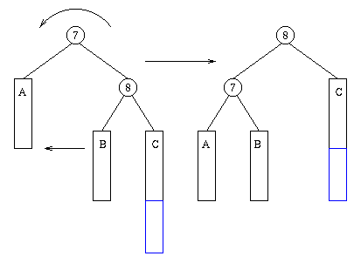
Another view…
Advanced Trees

Slide 22
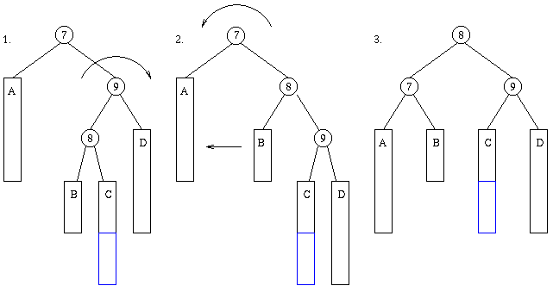
When a single rotation isn’t enough…
Advanced Trees

Slide 23
Double Rotation
G
S
P
D
P
G
S
C
D
A
A
B
B
C
S becomes the new root
  B gets the empty spot in the left subtree
  C gets the empty spot in the right subtree
Advanced Trees

Slide 24
Double Left Rotation
G
S
D
P
G
P
S
D
C
A
B
A
C
B
Mirror image of double right rotation
Advanced Trees

Slide 25
Keeping track of balance
Store left-height and right-height of each node
37
1
1
7
42
0
0
0
0
Advanced Trees

Slide 26
Keeping track of balance
Update as you return from recursive insertions/deletions
37
1
1
7
42
1
0
0
0
4
0
0
Advanced Trees

Slide 27
Keeping track of balance
s
On single rotations, only a few height values need to be recalculated
37
2
1
24
42
1
0
0
0
7
0
0
2
37
7
42
2
24
Advanced Trees

Slide 28
Class Exercise
40
20
60
10
30
50
70
5
12
25
35
Insert 37 into this AVL tree
If a double rotation is necessary, draw both steps
Advanced Trees

Slide 29
Class Exercise
+2
40
-1
20
60
-1
10
30
50
70
-1
5
12
25
35
37
Advanced Trees

Slide 30
First Step
40
20
60
10
30
50
70
5
12
25
35
37
Advanced Trees

Slide 31
Second Step
40
30
60
20
35
50
70
10
25
37
5
12
Advanced Trees

Slide 32
Result
30
20
40
10
25
35
60
5
12
37
50
70
Advanced Trees

Slide 33
The AVL tree
Just like a BST, but after every insert and delete operation, balance is checked, and a single or double rotation operation is done if necessary.
The rotation operations are O(1), so the insert time is still O(log n)
Tree is always balanced, so search is O(log n)
A cousin of the AVL tree is the Splay tree
  Details in your text on pp. 431 – 434
Advanced Trees

Slide 34
Red/Black Trees
See ZyBooks for intro
A red-black tree is a BST with two node types, namely red and black, and supporting operations that ensure the tree is balanced when a node is inserted or removed. The below red-black tree's requirements ensure that a tree with N nodes will have a height of O(log N).
Every node is colored either red or black.
The root node is black.
A red node's children cannot be red.
A null child is considered to be a black leaf node.
All paths from a node to any null leaf descendant node must have the same number of black nodes.
Binary Trees

Slide 35
Red/Black Trees
Balance is somewhat complicated:
The red-black balance operation consists of the steps below.
Set parent = node's parent, uncle = node's uncle, grandparent = node's grandparent.
If node is the tree's root, then color node black and return.
If parent is black, then return.
If parent and uncle are both red, then color parent and uncle black, color grandparent red, recursively balance grandparent, then return.
If node is parent's right child and parent is grandparent's left child, then rotate left at parent, node = parent, parent = node's parent, and go to step 7.
If node is parent's left child and parent is grandparent's right child, then rotate right at parent, node = parent, parent = node's parent, and go to step 7.
Color parent black and grandparent red.
If node is parent's left child, then rotate right at grandparent, otherwise rotate left at grandparent.
Binary Trees

Slide 36
Red/Black Trees
Insert 20 and balance:
20
2. If node is the tree's root, then color node black and return.
20
Advanced Trees

Slide 37
Red/Black Trees
Insert 30 and balance:
20
Parent
30
3. If parent is black, then return.
Advanced Trees

Slide 38
Red/Black Trees
Insert 40 and balance:
20
Grandparent
30
Parent
40
Node
Advanced Trees

Slide 39
Red/Black Trees
Insert 40 and balance:
20
Grandparent
30
20
40
30
Parent
40
Node
Color parent black and grandparent red.
If node is parent's left child, then rotate right at grandparent, otherwise rotate left at grandparent.
Advanced Trees

Slide 40
Red/Black Trees
Insert 50 and balance:
30
Grandparent
Uncle
20
40
Parent
50
Node
If parent and uncle are both red, then color parent and uncle black, color grandparent red, recursively balance grandparent, then return.
Advanced Trees

Slide 41
Red/Black Trees
Insert 50 and balance:
30
Grandparent
Uncle
20
40
Parent
50
Node
If parent and uncle are both red, then color parent and uncle black, color grandparent red, recursively balance grandparent, then return.
Advanced Trees

Slide 42
Red/Black Trees
Recursively balance grandparent:
30
Node
20
40
50
If node is the tree's root, then color node black and return.
Advanced Trees

Slide 43
Red/Black Trees
Insert 45 and balance:
If node is parent's left child and parent is grandparent's right child, then rotate right at parent, node = parent, parent = node's parent, and go to step 7.
30
20
40
Grandparent
50
Parent
Uncle
45
Node
Advanced Trees

Slide 44
Red/Black Trees
Insert 45 and balance:
If node is parent's left child and parent is grandparent's right child, then rotate right at parent, node = parent, parent = node's parent, and go to step 7.
30
20
40
Grandparent
50
Parent
Uncle
45
Node
Advanced Trees

Slide 45


Red/Black Trees
Insert 45 and balance:
If node is parent's left child and parent is grandparent's right child, then rotate right at parent, node = parent, parent = node's parent, and go to step 7.
30
20
40
Grandparent
Uncle
45
50
Advanced Trees

Slide 46
Red/Black Trees
Insert 45 and balance:
Color parent black and grandparent red.
30
20
40
Grandparent
Uncle
45
Parent
50
Node
Advanced Trees

Slide 47
Red/Black Trees
Insert 45 and balance:
If node is parent's left child, then rotate right at grandparent, otherwise rotate left at grandparent.
30
20
40
Grandparent
Uncle
45
Parent
50
Node
Advanced Trees

Slide 48
Red/Black Trees
Insert 45 and balance:
If node is parent's left child, then rotate right at grandparent, otherwise rotate left at grandparent.
30
20
45
40
50
Advanced Trees

Slide 49
Red/Black Trees
Insert 55 and balance:
If parent and uncle are both red, then color parent and uncle black, color grandparent red, recursively balance grandparent, then return.
30
20
45
Grandparent
Uncle
40
50
Parent
55
Node
Advanced Trees

Slide 50
Red/Black Trees
Insert 55 and balance:
If parent and uncle are both red, then color parent and uncle black, color grandparent red, recursively balance grandparent, then return.
30
20
45
Grandparent
Uncle
40
50
Parent
55
Node
Advanced Trees

Slide 51
Red/Black Trees
Recursively balance grandparent:
3. If parent is black, then return.
Parent
30
Out of balance for an AVL tree, OK for a red/black tree!
20
45
Node
40
50
55
Advanced Trees

Slide 52
Spatial Data Structures
Suppose we have a database of buildings and the keys are the x and y coordinates of the building on a map
We could use two BST’s, one for x and one for y, but this has disadvantages
  Expensive to search for all buildings in a certain rectangle, or all buildings close to another building
  Not a natural representation
This is an example of a multidimensional key
Advanced Trees

Slide 53
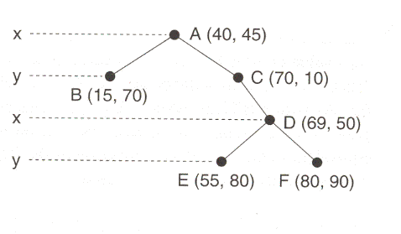
The K-D tree
Suppose you have a d-dimensional key
The K-D tree is a BST, but the decision at level i is based on the (i % k)^{th} dimension
K-D tree for cities at (40,50), (15, 70), (70, 10), (69, 50), (55, 80), and (80, 90).
Advanced Trees

Slide 54
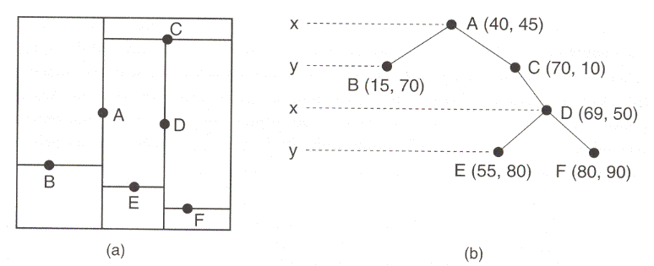
Spatial Decomposition
Each node in the tree represents a cut of the key space in a direction parallel to one of the dimensional axes:
As with a BST, the tree and the division of the key space depend upon the order in which the data are inserted into the tree.
Advanced Trees

Slide 55
Searching a K-D tree
At each level, decisions are made on only one coordinate
  Example – At level 1 of the following tree, records with y > 45 can be in either the right or left subtree of the root:
Example: Search for record (x, y) = (69, 50)
Advanced Trees

Slide 56
Implementation of Search
bool KDtree::findhelp(BinNode *subroot, int *coord, Elem &e, int discrim) const {
if (subroot == NULL) return false;
int *currcoord;
currcoord = subroot->coord();
if (EqualCoords(currcoord, coord)) {
e = subroot->val();
return true;
}
if (curcoord[discrim] < coord[discrim])
return findhelp(subroot->left(), coord, e, (discrim+1)%D);
else
return findhelp(subroot->right(), coord, e,
(discrim+1)%D);
}
Advanced Trees

Slide 57
K-D Insert
Insert into a K-D tree is similar to BST insertion
  First search until a NULL pointer is found
  Insert the new record into the proper child pointer
Advanced Trees

Slide 58
K-D delete
K-D delete is more complicated than BST delete. To delete a node, N:
  If N has no children, replace it with a NULL
  If N has two children, we must find the smallest value in the right subtree. However we must find the smallest value for the same discriminator
  Not necessarily leftmost, since some branches are not based on this discriminator
    Use a modified findmin() routine
  Then we call delete recursively to remove the min node.
Advanced Trees

Slide 59
K-D delete example
X
A (30, 50)
B (20, 40)
C (32, 70)
Y
X
D (25, 33)
E (15, 72)
F (52, 12)
G (35, 88)
Y
H (33, 74)
I (37, 92)
Advanced Trees

Slide 60
KDTree::findmin()
BinNode* KDtree::findmin(BinNode *subroot, int discrim, int currdis) const {
BinNode *temp1, *temp2;
int *coord, *t1coord, *t2coord;
if (subroot == NULL) return NULL;
coord = subroot->coord();
temp1 = find findmin(subroot->left(), discrim, (currdis+1)%D);
if (temp1 != NULL)
t1coord = temp1->coord();
if (discrim != currdis) { // Min could be on either side:
temp2 = findmin(subroot->right(), discrim, (currdis+1)%D);
if (temp2 != NULL)
t2coord = temp2->coord();
if ((temp1 == NULL) ||
((temp2 != NULL) &&
t2coord[discrim] < t1coord[discrim])))
temp1 = temp2;
} // Now temp1 has the smallest value of subroot’s children
if ((temp1 == NULL) || (coord[discrim]<t1coord[discrim]))
return subroot;
else return temp1;
}
Advanced Trees

Slide 61
Deleting (2)
If there is no right subtree, we can’t just find the max value in the left subtree, because it might be duplicated, and duplicates belong in the right subtree.
Instead, we can move the left subtree to the right and then replace the node to be deleted with the minimum value, just as before
Advanced Trees

Slide 62
Class Exercise
Delete the root
(72, 95)
(64, 12)
(87, 65)
(68, 8)
(45, 112)
(102, 40)
(89, 30)
Advanced Trees

Slide 63
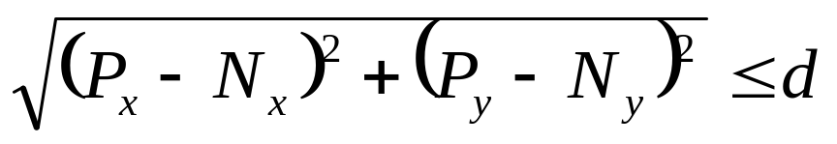
Radius search
Suppose we want all points within distance d of a query point
When the difference between the query point and the search point is greater than d in any dimension, the query point clearly cannot be within distance d
  We can disregard an entire subtree at a time
Advanced Trees

Slide 64
Radius Search (2)
Search for all points within 25 units of (25,65)
  Root (A) distance = 25, report
  Root node: x = 40 – check both children
  Report B, no children
  Do not report C, check children
    No left child. Right child: y ≥ 10, must be checked
  Do not report D, check children
    Left: x < 69 – much check
    Right: x ≥ 69 – no children can match, skip entire subtree
  Check E, do not report
x = 50
25, 65
y = 40
y = 90
x = 0
Advanced Trees

Slide 65
The PR Quadtree
Like a BST, the location of the cuts in a K-D tree depend on the objects and the order in which they are presented
The equivalent of a trie for spatial data structures is the PR (Point-Region) Quadtree
Every node has four children, which cut the x and y dimensions in half
  Three-dimensional equivalent is an octree
Advanced Trees

Slide 66
Quadtrees
Nodes have four children or none
E
NW
NE
SW
SE
C
A
B
D
(30, 90)
(95, 85)
A
B
E
(110,25)
This quadtree will result, no matter what order the data are presented in.
C
D
(98, 35)
(117, 52)
Advanced Trees

Slide 67
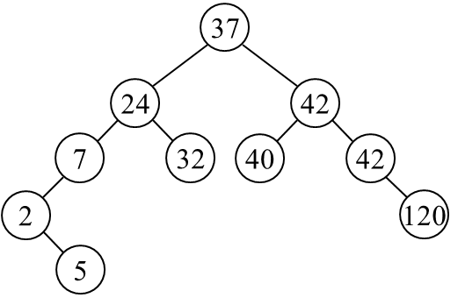
Class Exercise
Advanced Trees

